Slide 1
Widrow-Hoff (LMS) Procedure
By: Dylan Baxter, Nathan Jaggers, Jordan Perlas, Ronit Singh

Slide 2

LDF Background
Function with weights (w) and bias (w₀) with inputs (x)
g(x) = + or - 1, if g(x) < or >= 0
Assign to class, update weight, find final decision surface
Notes:
ronit

Slide 3
Widrow-Hoff (LMS) Background
Created by Widrow and Hoff in 1960
LMS stands for Least-Mean-Squared
Tries to minimize distances of training points to hyperplane
Gradient Descent algorithm
Similar to Fixed-Increment Single Sample
Notes:
jordan

Slide 4
LMS Procedure
Initialize Terms
a = weight vector
b = arbitrary distance vector
𝜂 = learning rate
Y = feature vector
Iterate through training samples
Calculate gradient
Adjust weights
Repeat 2 until the weight correction is below a specific threshold
Return weights once threshold is met
Notes:
ronit

Slide 5
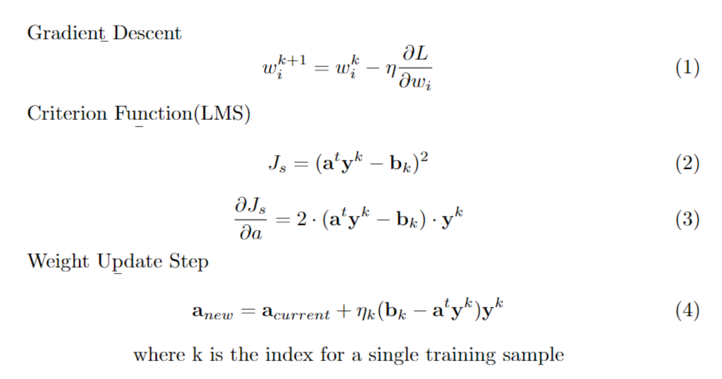
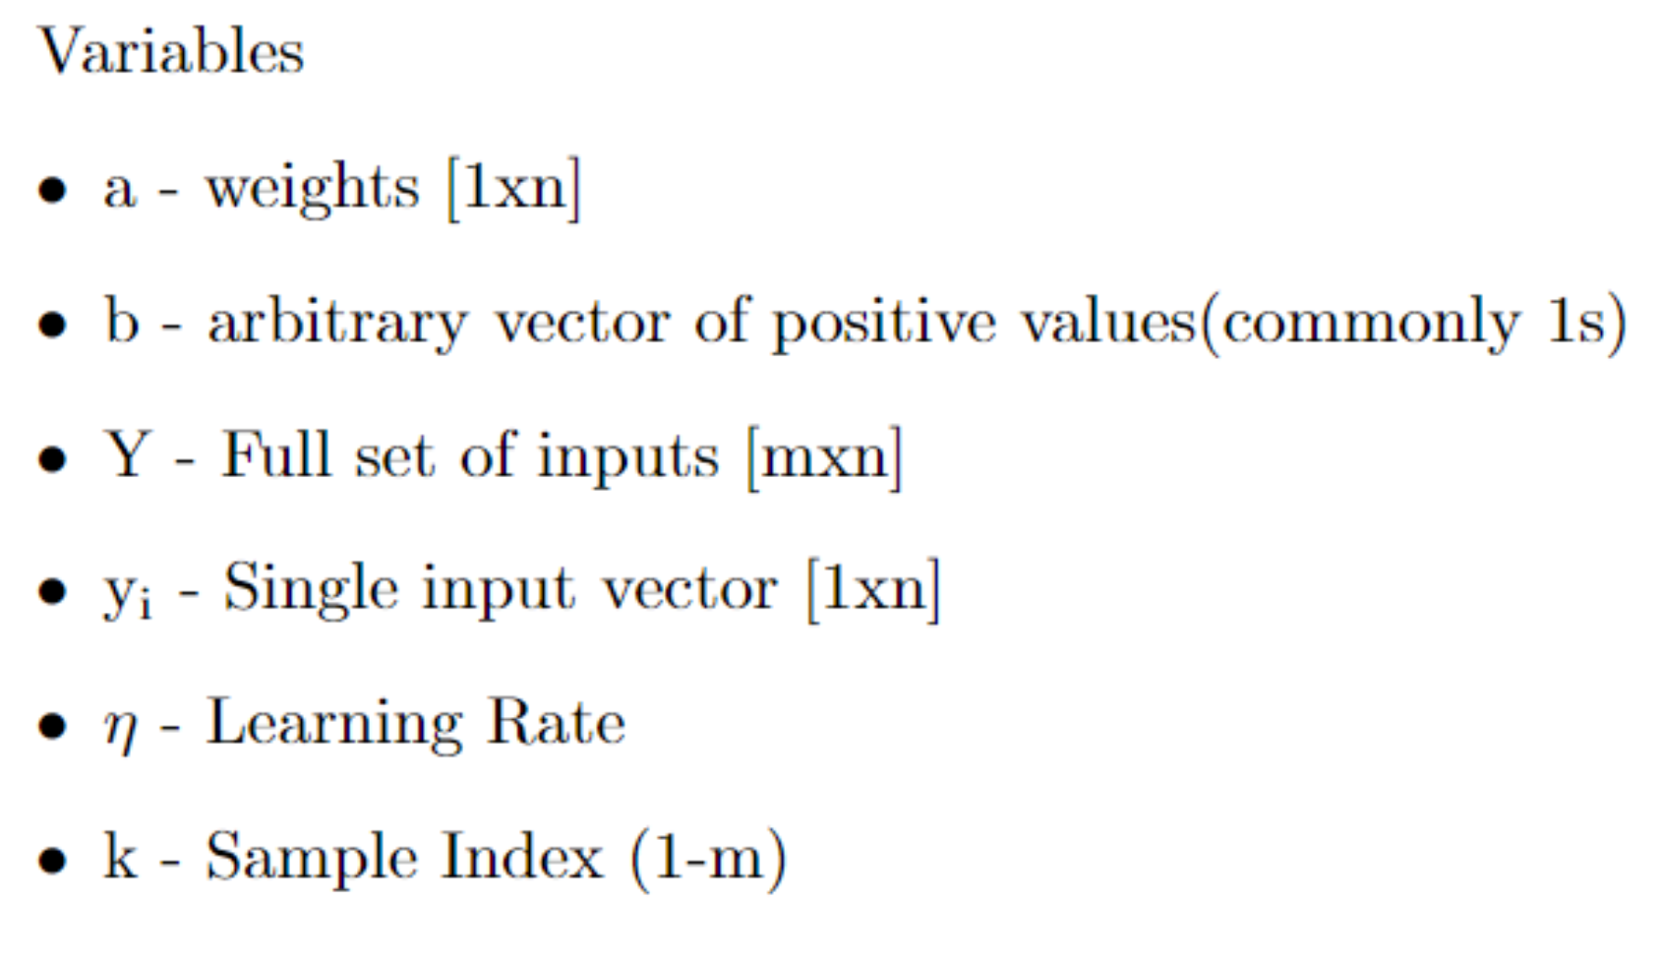
Equations
Notes:
Dylan

Slide 6
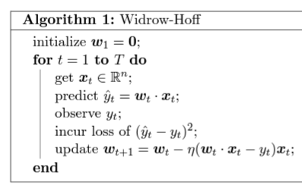
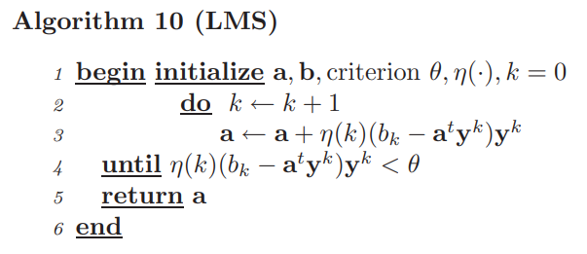
LMS Procedure (Pseudocode Version)
Our assigned textbook
Princeton’s version
Notes:
dylan

Slide 7
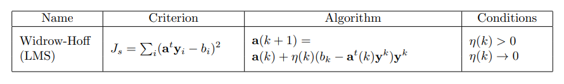
LMS Procedure Summary
Loss is sum of error from g(y) to b for all training samples
Weights adjusted by the negative of the loss gradient on per sample basis
Learning rate should approach 0 as training continues
Training exits when adjustments fall below a set threshold
Notes:
Thank you for making this look nice Dylan

Slide 8
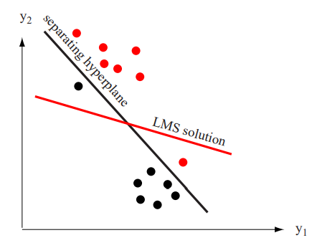
LMS Example
The Widrow-Hoff procedure can converge on a solution that is not the separating hyperplane.
Notes:
Can draw example of LMS solution iterations if you think example would be helpful. It is important to know that when using Wodrow-Hoff/LMS, that just because you get a solution doesn’t mean you’ve found a separating hyperplane. Here we have an example visual of that.

Slide 9
Advantages and Disadvantages
Advantages
Automatically deals with computational problems that arise from truncation or roundoff
Avoids large matrices for easier computation
Disadvantages
Can get stuck at local minimum
Arbitrary b vector gets correct solution but not best solution
Notes:
jordan

Slide 10


Comparison to MSE
Similarities
-Many of the same variables and initial legwork
Differences
- Determines values of vector a through gradient descent rather than the pseudoinverse.
Large Storage
High compute
Does not consider a singular YtY
Notes:
Nathan

Slide 11
References
Hart, Peter E., et al. Pattern Classification 2nd Ed. Academic Internet Publishers, 2007.
The Widrow-Hoff Algorithm - Princeton University. https://www.cs.princeton.edu/courses/archive/spring13/cos511/scribe_notes/0411.pdf.

Slide 12
Questions?

